Slide 1

General Assembly Meeting
86th Annual Reunion
August 31 – September 2, 2018
Myrtle Beach, SC

Slide 2

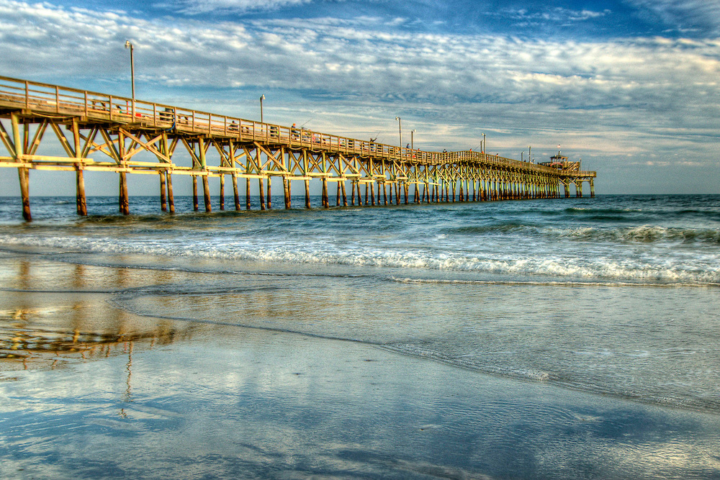
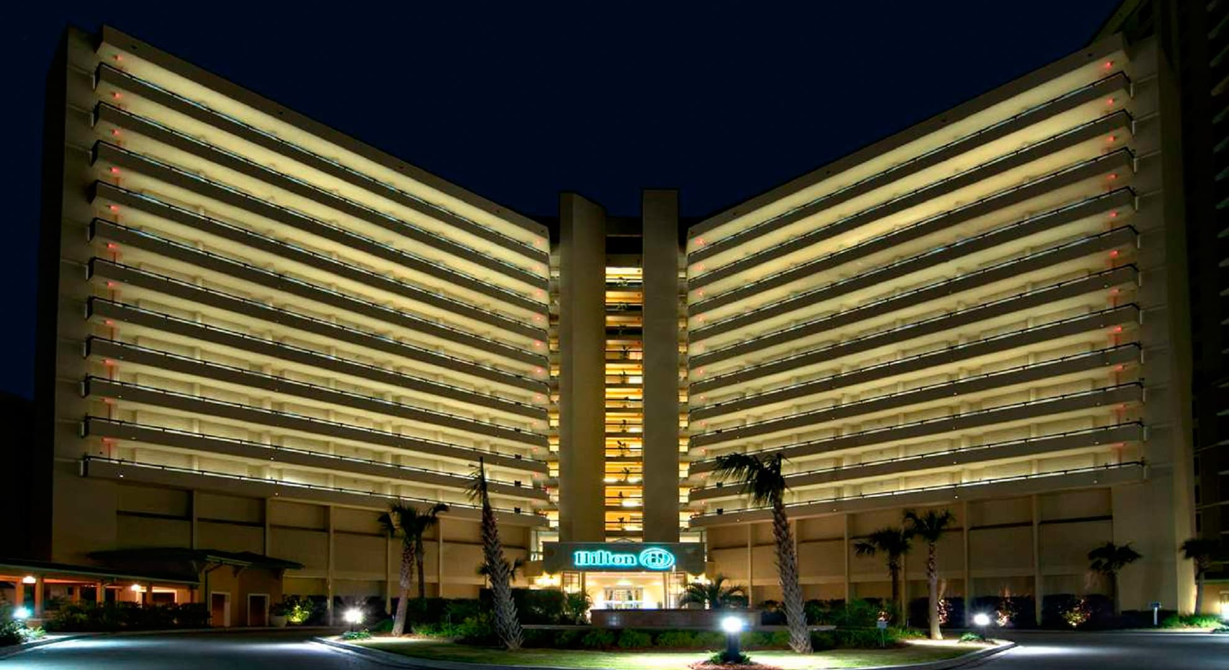
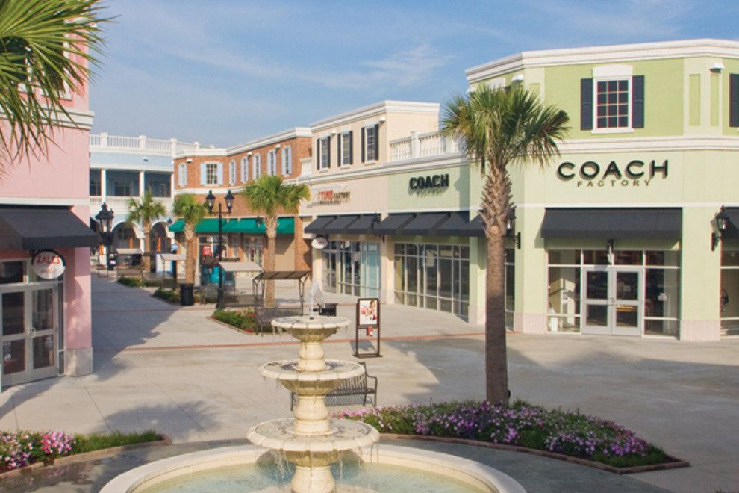
Welcome to Myrtle Beach, SC!

Slide 3

Kfeirian Reunion
Foundation Seal
    In 1967, George Hanna felt our Foundation needed its own emblem to be readily identified. After several considerations, George and two artist friends, Jerry Sutphin and Bill Dawson, began designing an emblem.
    What symbol would best reflect the origin of our organization? A green Cedar from Lebanon and red circle with white lettering was solidly chosen.
    After George had a local trophy company cut out parts of the emblem, he and Jerry hand painted and assembled it. The finished emblem was presented and unanimously accepted by the Reunion’s General Assembly, thereby officially becoming the Foundation’s seal on September 1, 1968.

Slide 4

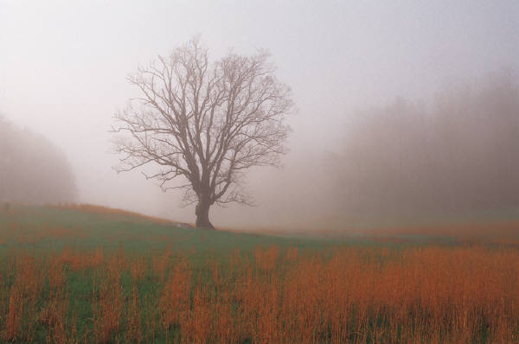
Kfeirian Reunion Initiative
*Our Mission toward 100 years
of Reunions and beyond*
Maintain a Board of Trustees to move forward and build a strong foundation for our children, grandchildren, great-grandchildren and so on.
Continue traditions passed down to our families.
Remember and recognize our loved ones who are no longer with us and have committed their time and effort to keep these reunions and traditions alive.
Keep the reunions active by combining today’s traditions with the past.

Slide 5


Kfeirian Reunion Historical Records
The historical Kfeirian Reunion records are being stored in Marshall University’s Morrow Library in Huntington, WV.
These records include:
  * Newsletters
  * Kfeirian Commemorative Books
  * Directories
  * Past reunion programs
  * Miscellaneous Correspondence
If you have any questions or records that you wish to donate, please email us at reunion@kfeir.com.

Slide 6
Treasurer’s Report
Checking Account: $10,100.39
Savings Account: $ 3,883.82
Investment Account: $22,743.38

Slide 7
Reunion Projects
A water system in the Kfeir
An electrical system in the Kfeir
A road leading to the Kfeir
Junior college established with material assistance
Sent $5000 for Orthodox Church renovation
Sent $500 for 6 needy families in Kfeir

Slide 8

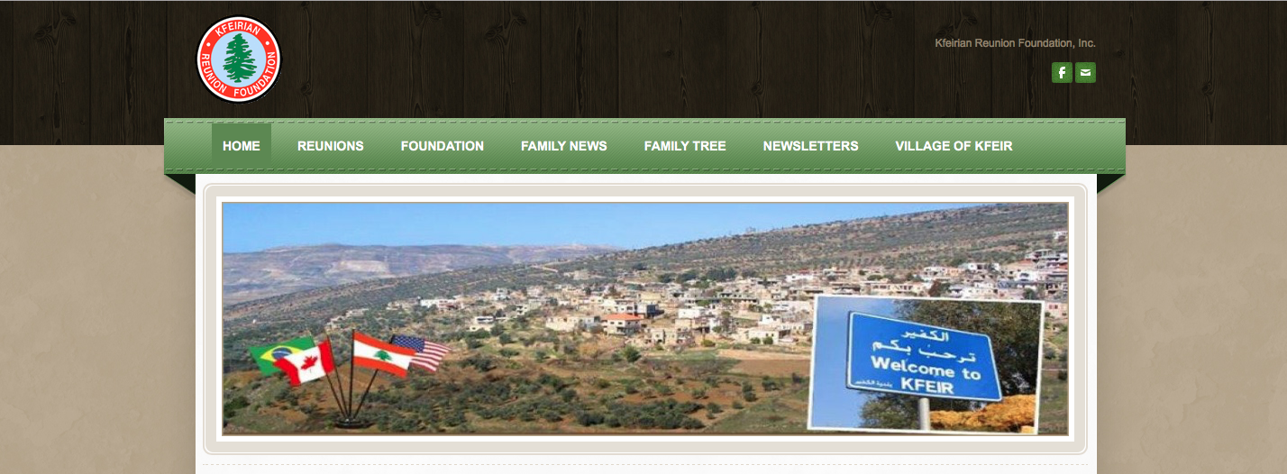
Kfeirian Website
www.kfeir.com
Explore the website for:
Past Reunion Pictures and Highlights
Newsletters and Programs
Foundation and Scholarship Information
Family Tree information
Village of Kfeir
Current Board of Trustees
Kfeir Travel & Retail Links
Other Resources/Links
Contact information

Slide 9


Kfeirian Website
New Section on www.Kfeir.com
Click on Family News
Check out “Family History” and click on the names to read interesting stories
Have a family story to add to this section?
  Email your story at Reunion@kfeir.com.

Slide 10

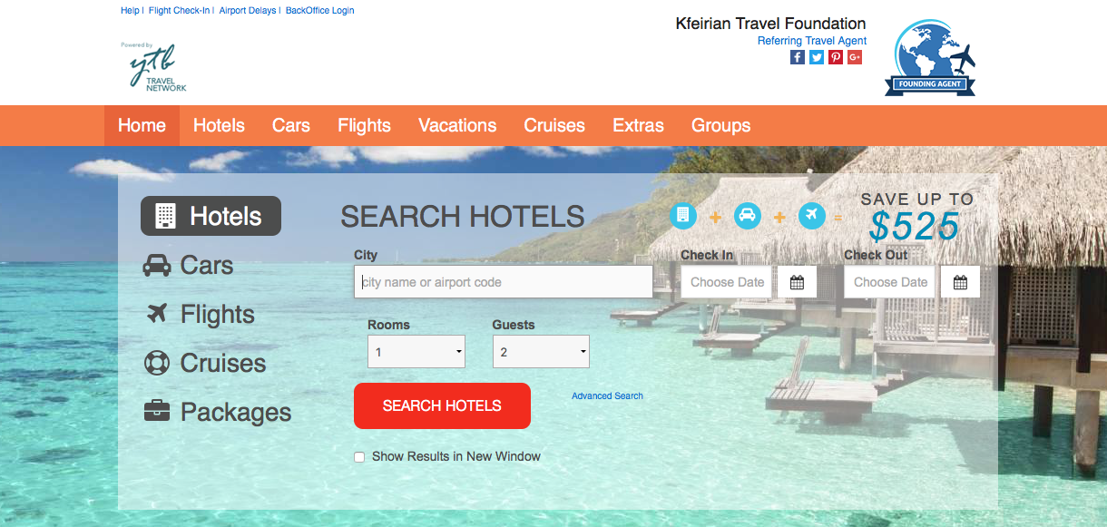

Travel Website
www.kfeirtravels.com
When you book your trip on this website, a portion goes to the Foundation
Please sign up for the newsletter to get the latest deals and steals
If you have any questions, please email us at reunion@kfeir.com

Slide 11

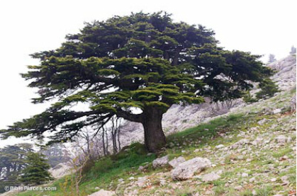
Genealogy
“… the Kfeirian Reunion was founded for the purpose of getting acquainted and meeting old friends, and that our children who were born under the skies of Liberty will know each other, particularly their genealogy and where they came from.”
~ Sol Steffan - Kfeirian Reunion 1965 ~
For any questions or access to the
Kfeirian Family Tree, please contact
Kevin Donley at kdonley17@gmail.com

Slide 12

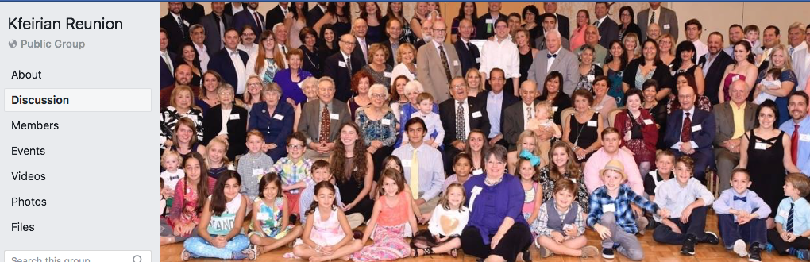
Please Join Our Kfeirian Reunion FB Page!
HAVE
?
Search on FaceBook for “Kfeirian Reunion” under Groups.
If you’re unable to find us, please contact us at reunion@kfeir.com.

Slide 13


Kfeirian Reunion
Scholarship Program
Requirements
    Financial need
    Leadership
    Scholastic ability
Limited to four years and designed for courses leading to an undergraduate degree in an accredited college or university.
Application and full summary of requirements located on www.kfeir.com.
**Recipients will be announced at the Sunday banquet.**

Slide 14

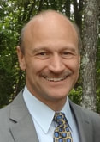
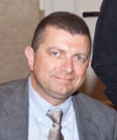
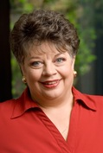
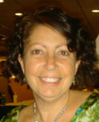
Board of Trustees
2017-2018
Michael Abraham
President (as of 2017)
Elected 2016
(2019)
Thomas Bevins
Secretary & Scholarship Committee
Elected 2015
(2018)
Sherry Mickel Parrish
Vice President & Scholarship Committee
Elected 2017
(2020)
Denise Mickel Russell
Treasurer, Webmaster & Scholarship Chair
Elected 2016
(2019)

Slide 15
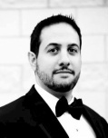
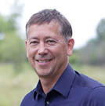
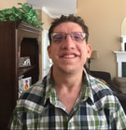
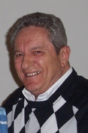
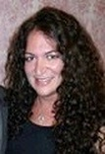
Board of Trustees
2017-2018
Abe Saad
Past President
Elected 2017
(2020)
Kevin Donley
Genealogist
Nicholas Joseph
Reunion Ambassador
George Hanna
Treasurer Emeritus
Laura Wisniewski
Board Member & Sunshine Committee
Elected 2017
(2020)

Slide 16
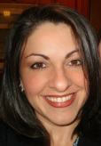
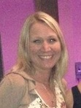
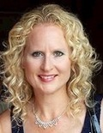
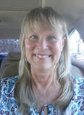
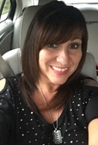
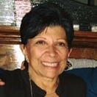
Board of Trustees
2017-2018
Board Members
Lori Thabet
Elected 2015
(2018)
Kimberly Thomas
Elected 2016
(2019)
Jennifer
Sleeman-Thabet
Elected 2015
(2018)
Nora Abraham Elected 2017
(2020)
Charlotte Sadd Lechlak
Elected 2016
(2019)
Christy McCoy Elected 2015
(2018)

Slide 17

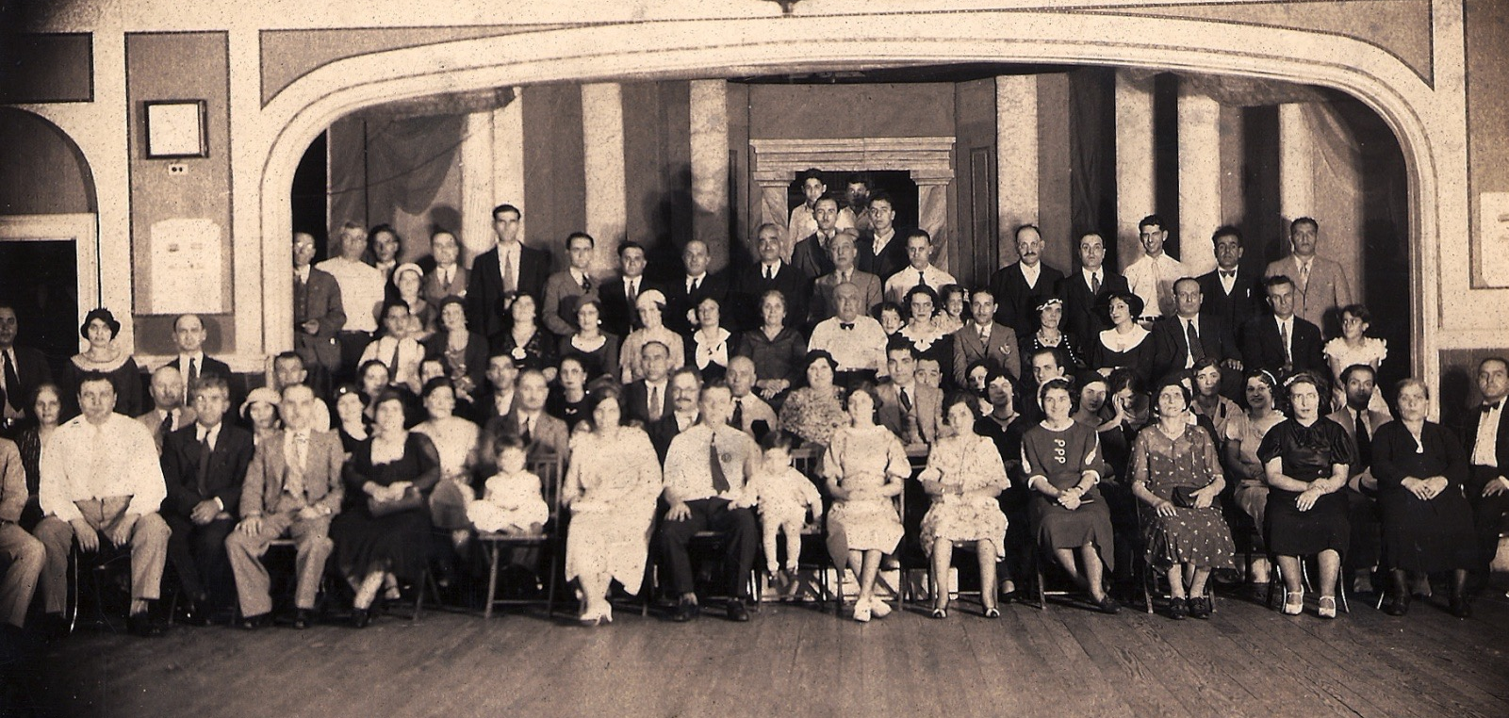
Our Founders
We are working on a project to identify the founders in this 1933 portrait. If you can help, check out the poster at the registration table or visit Kfeir.com and email responses to reunion@kfeir.com.

Slide 18

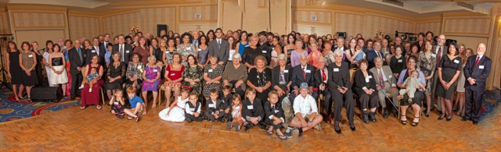
Group Picture
2012

Slide 19
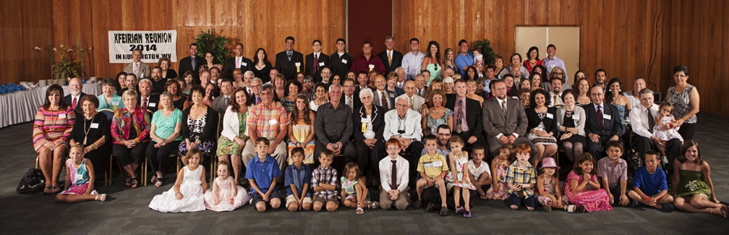
Group Picture
2013

Slide 20
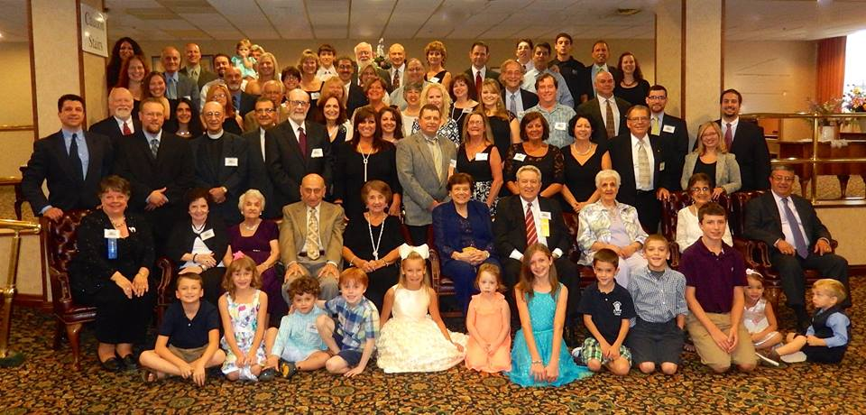
Group Picture
2014

Slide 21
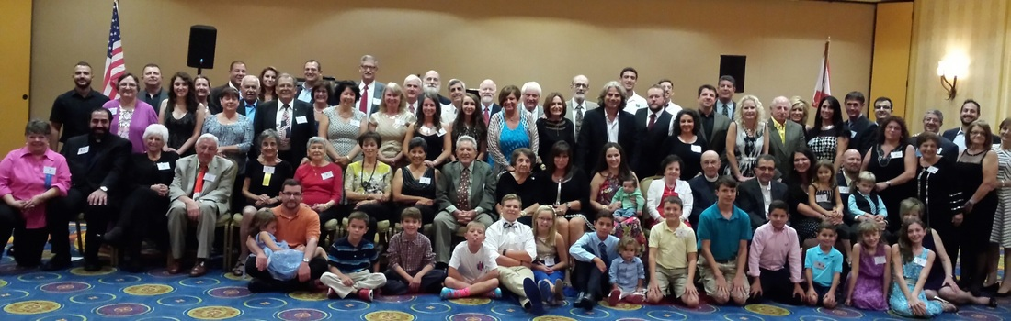
Group Picture
2015

Slide 22
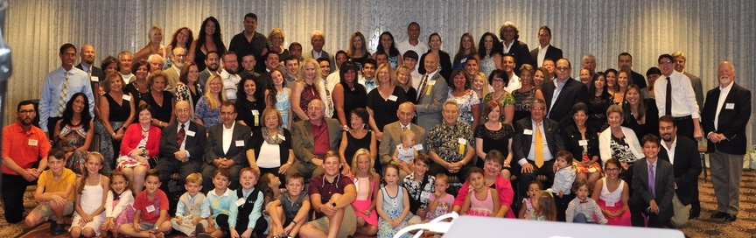
Group Picture
2016

Slide 23
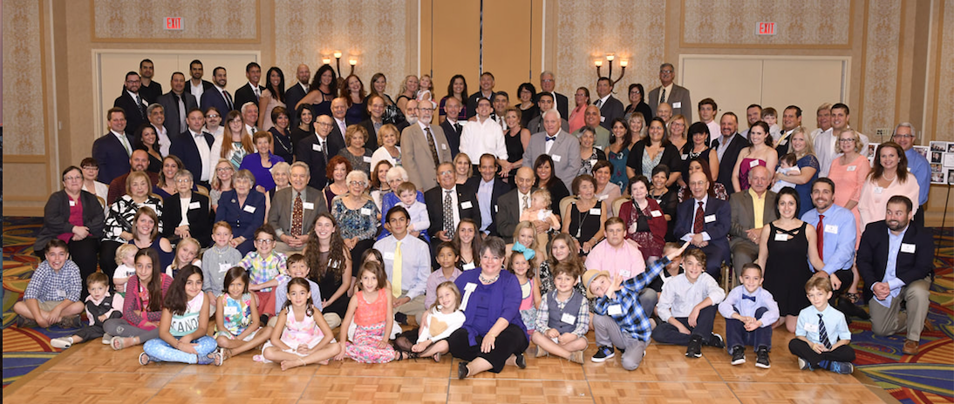
Group Picture
2017

Slide 24
Group Picture
2018
The group picture will be taken at the end of the Grand Banquet.

Slide 25

Previous Years Youth Attendance
(Ages 17 & Under)
  2017 – Charleston, WV ~ 29
  2016 – Myrtle Beach, SC ~ 20
  2015 – Charleston, WV ~ 22
  2014 – Huntington, WV ~ 27
  2013 – Myrtle Beach, SC ~ 37
  2012 –Charleston, WV ~ 25
  2011 – Myrtle Beach, SC ~ 34

Slide 26

See You Next Year!!
In Charleston, WV

