Slide 1

Kfeirian Announcements

Slide 2
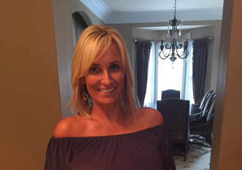
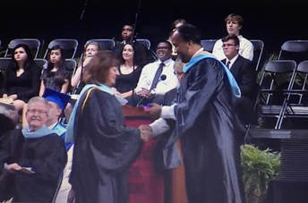
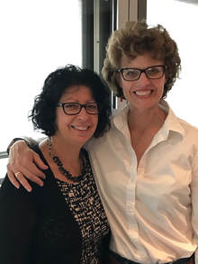
Retirements
Valerie Slater retired after 26 years as a Guidance Counselor in Pike County School System. She was also the director of Pike County’s Safe Schools Program. Valerie is married to Paul David Slater.
Sandy Mickel Ruder accepts her "golden diploma" from the Principal and School Board of Henrico County at the graduation ceremony of Hermitage High School class of 2018.
After 39+ years working across three Federal Reserve Bank (FRB) Offices, Denise Mickel Russell has retired!

Slide 3
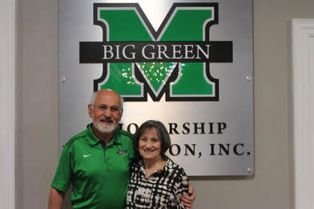
Achievements
Larry and Cheryl Tweel recently created an endowment through the Big Green Scholarship Foundation, the fundraising arm of Marshall athletics specifically for the men's basketball program.

Slide 4
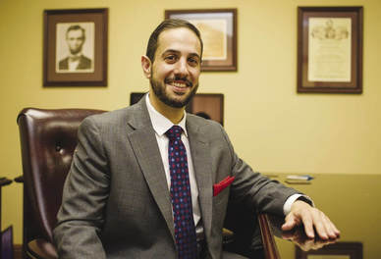
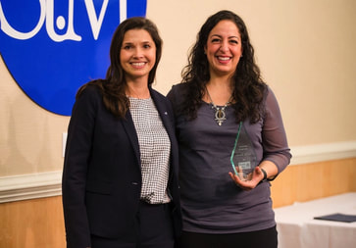
Abe Saad Recognized in the Herald Dispatch for his love for history. Judicial system propelled his path to becoming a successful attorney.
Achievements
Christina Saad McNeely Volunteer of the Year award during the United Way of the River Cities' annual Celebration of Excellence on Thursday, March 29, 2018.
GO TO KFEIR.COM UNDER FAMILY NEWS TO READ FULL ARTICLE.

Slide 5
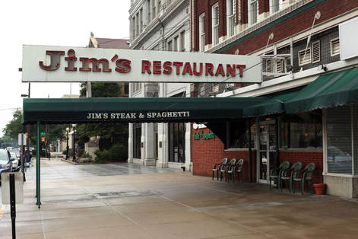
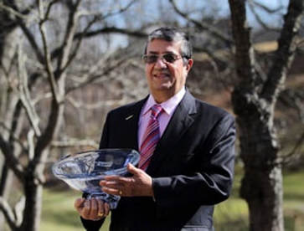
Achievements
Jim's Restaurant Celebrates 80 Years
In honor of its 80th anniversary, Jim's Steak and Spaghetti House will held a public celebration on Saturday, June 9. "The fact that we're still here speaks volumes about the commitment of our customers," general manager Jimmie Tweel Carder said.
Huntington chamber selects Julian Saad for top volunteer award
GO TO KFEIR.COM UNDER FAMILY NEWS TO READ FULL ARTICLE.

Slide 6
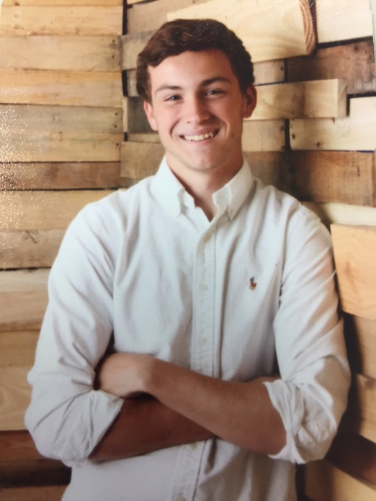
Graduations
Michael Raymond Abraham is the son of Mike and Nora Abraham of Saint Johns, Florida and the grandson of Raymond Abraham and the late Mary Abraham of Huntington, WV. Michael’s great grandfather Mike Abraham of Williamson, WV has been noted in historical Kfeirian documents as participating in and being master of ceremonies for many of our early reunions.
He is a 2018 graduate of Creekside High School in Saint Johns, Florida.
GO TO KFEIR.COM UNDER FAMILY NEWS TO READ FULL STORY

Slide 7
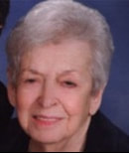
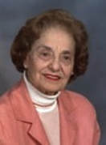
Obituaries
Clemence “Cle” Thabet Bassett, age 91 of Blissfield, passed away Tuesday, September 19, 2017, at home with her family. She was born March 4, 1926, in Kfeir, Lebanon to Toufic and Rasmia (Lowen) Thabet. Clemence graduated from South Charleston High School in 1944. She married Farris Bassett on October 15, 1946, and they celebrated over 50 years together before his death.
Rosalie Russo George, 92, of Huntington, died Friday, October 27, 2017, at Midland Meadows.
GO TO KFEIR.COM UNDER FAMILY NEWS TO READ FULL OBITUARY.

Slide 8
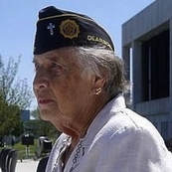
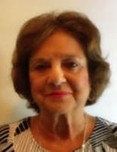
Obituaries
Mary Catherine Thabet (Donley) Husson passed away December 6, 2017. Dearest mother of Kevin (Monica) Donley, Colleen Donley, James (Ivana) Donley, and Richard (Carolyn) Donley. Loving grandma of Ryan, Emily, Sydney, Allison, Shannon, Duncan, Dylan, Brandon, Kenzie, and Samantha.
Note: Mary attended the 85th reunion in Charleston, WV.
Yvonne Susan Lowen Gigliotti died December 20, 2017, at Beaumont Hospital in Royal Oak. She was 70 years old. Yvonne was born November 28, 1947, in Charleston, West Virginia.
GO TO KFEIR.COM UNDER FAMILY NEWS TO READ FULL OBITUARY.

Slide 9
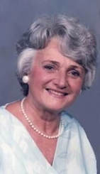
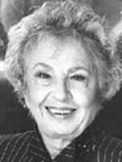
Obituaries
Livia A. Rahall, 92 of Ellwood City, PA formerly of Bellevue, passed away on Thursday, December 28, 2017
Julienne M. Newey passed away peacefully on Wednesday, June 6, 2018, at Hospice in Jacksonville, Florida. Julienne was born on February 5th in Beckley, West Virginia, to Nick Rahall and Daley Fackuri Rahall.
GO TO KFEIR.COM UNDER FAMILY NEWS TO READ FULL OBITUARY.

Slide 10
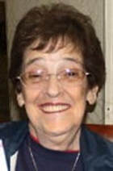
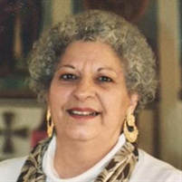
Obituaries
Jeanette Bassett Basham, 84, of Huntington WV died peacefully on Monday, June 11, 2018. Jeanette was born on July 21, 1933, the daughter of the late Kallel and Emily Bassett. She was preceded in death by her sister, Elaine Bassett Rahal.
Beverly A. Kerbawy, age 82 of Allen, formerly of Blissfield and Moshierville passed away Saturday, August 18, 2018, at Hillsdale County Medical Care Facility.
GO TO KFEIR.COM UNDER FAMILY NEWS TO READ FULL OBITUARY.

Slide 11
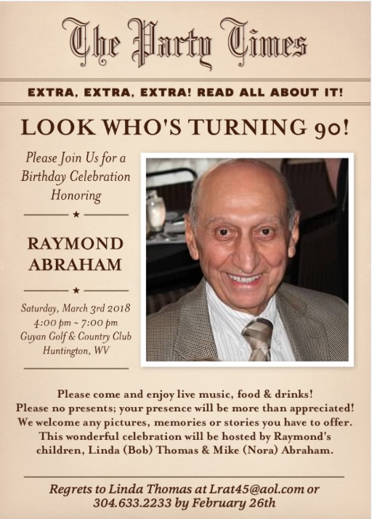
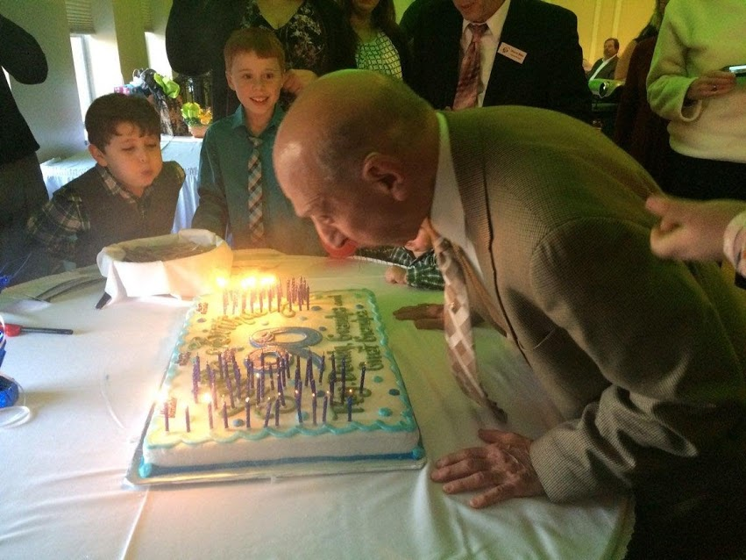
Raymond Abraham Celebrates
His 90th Birthday!
On Saturday, March 3, 2018, with many family and friends present, Raymond Abraham celebrated his 90th birthday at the Guyan Golf & Country Club in Huntington, WV. Happy Birthday Ray!

Slide 12
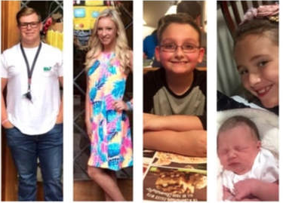
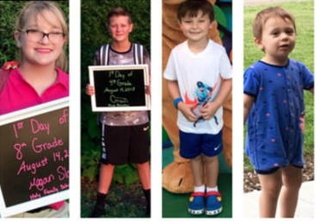
The Great-Grandchildren of the Jeanette Cantees McCoy (92) Clan have been very busy this year!!
From L to R: Cade Slater, Cassidy Slater, Dustin McCoy, Ryesen Lillee McCoy, Megan Slater, Grant Slater, Lincoln Payne (3), Jett Wilson (1)

