Slide 1

Kfeirian Announcements

Slide 2
Obituaries
Mary Alice Rahall, 93, of Beckley, passed away Sunday, September 30, 2018. Born August 2, 1925 in Beckley, she was the daughter of the late Asaff and Jamelia Rahall. Mrs. Rahall was a member of Judea Shrine #13 Order of the White Shrine of Jerusalem, Order of the Eastern Star Bethlehem Chapter #71, Order of St. Ignatius of Antioch. She was the American Mothers, Inc. 1986 Mother of the Year. She is survived by her children, Nick Joe Rahall, II and wife Melinda of Beckley, Victoria Lynn Hassler and husband Paul of Denver, NC, Tanya Alice Rahall of Washington, D.C. and several grandchildren.
GO TO KFEIR.COM UNDER FAMILY NEWS TO READ FULL OBITUARY.

Slide 3
KAWAJA, George Habib, 94, of Lexington, Ky, passed away Dec 8, 2018, with his family at his bedside. Born in Kfeir, Lebanon, he emigrated to this country in his early twenties. He and his wife Yvonne made their home in Hazard, Ky, where they owned George's Shoe Store. They also owned Radwan's Shoe Store in Pikeville and George's Shoes in Lexington. George was preceded in death by his wife of 49 years.
Geraldine T. (Bassett) Deschenes, 72, of Windham, NH, passed peacefully on December 26, 2018, surrounded by her family. “Gerrie” to her friends, “Sitto” to her grandchildren, she suffered from physical ailments for many years, some since birth, yet never let them hold her back from achieving much. Born in Methuen, MA on January 19, 1946, she was the only child of the late Michael Bassett, a Lebanese immigrant and owner of Michael J. Bassett Hardware in Lawrence, and the late Salma Bassett of Lawrence, MA.
GO TO KFEIR.COM UNDER FAMILY NEWS TO READ FULL OBITUARY.

Slide 4
Ayoub Fares Rahall, 85, of Huntington passed away peacefully on January 20th, 2019 at the Emogene Dolin Hospice House in Huntington. Ayoub was the son of the late Fares and Zahia Rahall of Lebanon. He was preceded in death by his late wife, Elaine Bassett Rahall of Huntington, his sister, Niamee Rahall Fakoury and brother, George Rahall of Lebanon. Ayoub immigrated to Huntington from Lebanon in 1961.
Ayoub is survived by his loving wife, Mary Emily Rahall of Huntington; his brother, Joseph Rahall of Lebanon; his sister, Mary Rahall Ishac of Lebanon; his daughters, Rebecca Rahall Anderson (Troy) and Susan Kimberly Rahall both of Raleigh, NC, his grandchildren, step-children and step-grand-children.
GO TO KFEIR.COM UNDER FAMILY NEWS TO READ FULL OBITUARY.

Slide 5
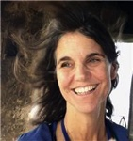
Jan Rutherdale, beloved to friends and family alike, died of heart failure on February 23, 2019. She has left us much too soon. Jan was born in 1956 in Los Altos, California, to Alice and Jack Rutherdale. Along with her twin brother, Jay, she was the youngest of five siblings. After graduating high school in three years, Jan went off to college at Oberlin (Ohio) and then law school at Hastings College of Law (San Francisco). She married her high school sweetheart, Jeff Bush, in 1978. In 1982, they moved to Juneau where Jan began a successful career as a public attorney.
Jan's bright smile will be remembered by all who knew her. Jan is survived by her daughters Megan Moody (Justin) and Isabel Bush, sisters Nancy Griffith (Tom) and Martha de la Soujeole (Axel), brother Jay Rutherdale (Sydney), step-mother Anne Rutherdale (Karl), partner Fred Shields, and numerous nieces, nephews, and others.
GO TO KFEIR.COM UNDER FAMILY NEWS TO READ FULL OBITUARY.

Slide 6
Rebecca Ann (Zegeer) Gouge, 63, of Clayton, N.Y., passed away Sunday, February 24, 2019, at Samaritan Medical Center in Watertown, N.Y., after a long illness. Born in Charleston, W.Va., January 13, 1956, she was the daughter of Harry Soloman and Mary Frances (McCarus) Zegeer. Rebecca graduated from Charleston High School and continued her education at WVU where she received her degree in Psychology.
George Abraham Cassis departed this life on July 22, 2019 at the age of 83. George is survived by his loving wife Evelyn of 57 years, son Dr. Jeffrey George Cassis of Washington, D.C. (loving companion Rebecca Rorke), Brian Matthew Cassis (Julia) and the “apple of his eye” granddaughter Caroline Mae Cassis whom he loved deeply and was so proud of her music accomplishments.
GO TO KFEIR.COM UNDER FAMILY NEWS TO READ FULL OBITUARY.

Slide 7
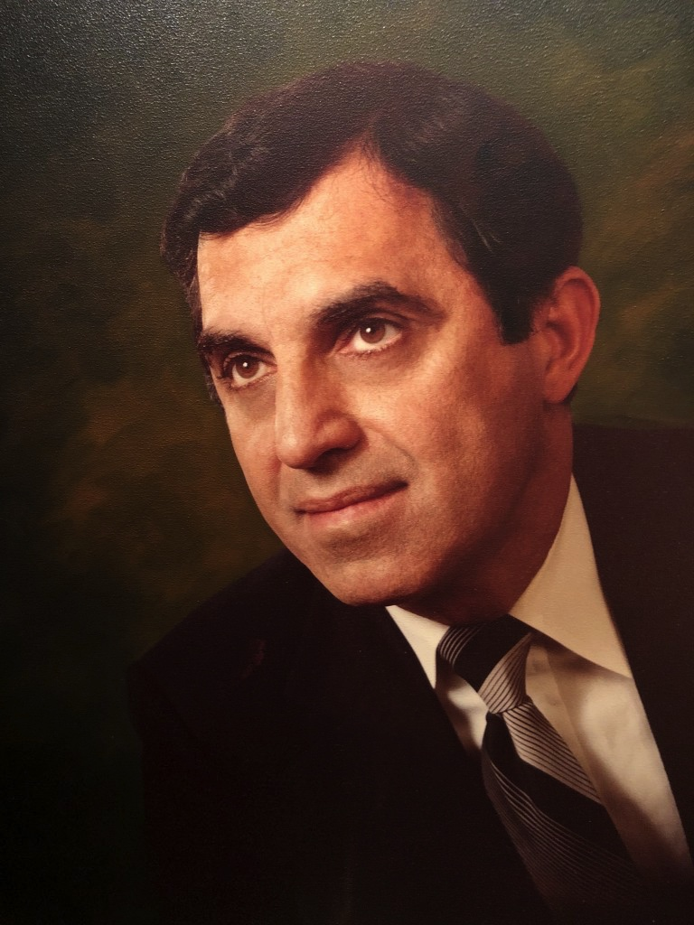
Joseph S. Bassett, M.D., a longtime prominent Metro Detroit Cardiovascular Surgeon, died on August 21, 2019 in Royal Oak, Michigan. He is survived by his loving wife, Anna (nee Mancini), his nephew, David Mancini and many, many wonderful friends and cherished colleagues.
Dr. Bassett cared for thousands of patients over his 50 plus year career in several different hospital systems. He held positions as an active and courtesy staff member in the Cardiothoracic Surgery Department at several locations.
The world has lost a loving husband, a dedicated and caring physician, a pioneer in modern medicine, a wonderful and trusted colleague and a true friend to all who knew him. He will be missed.
GO TO KFEIR.COM UNDER FAMILY NEWS TO READ FULL OBITUARY.

